Slide 1
BIRDS-5
Weekly Update for Communication Subsystem
Long Range Test Update
03-February-2022
Ramson Nyamukondiwa
Edgar Mujuni

Slide 2
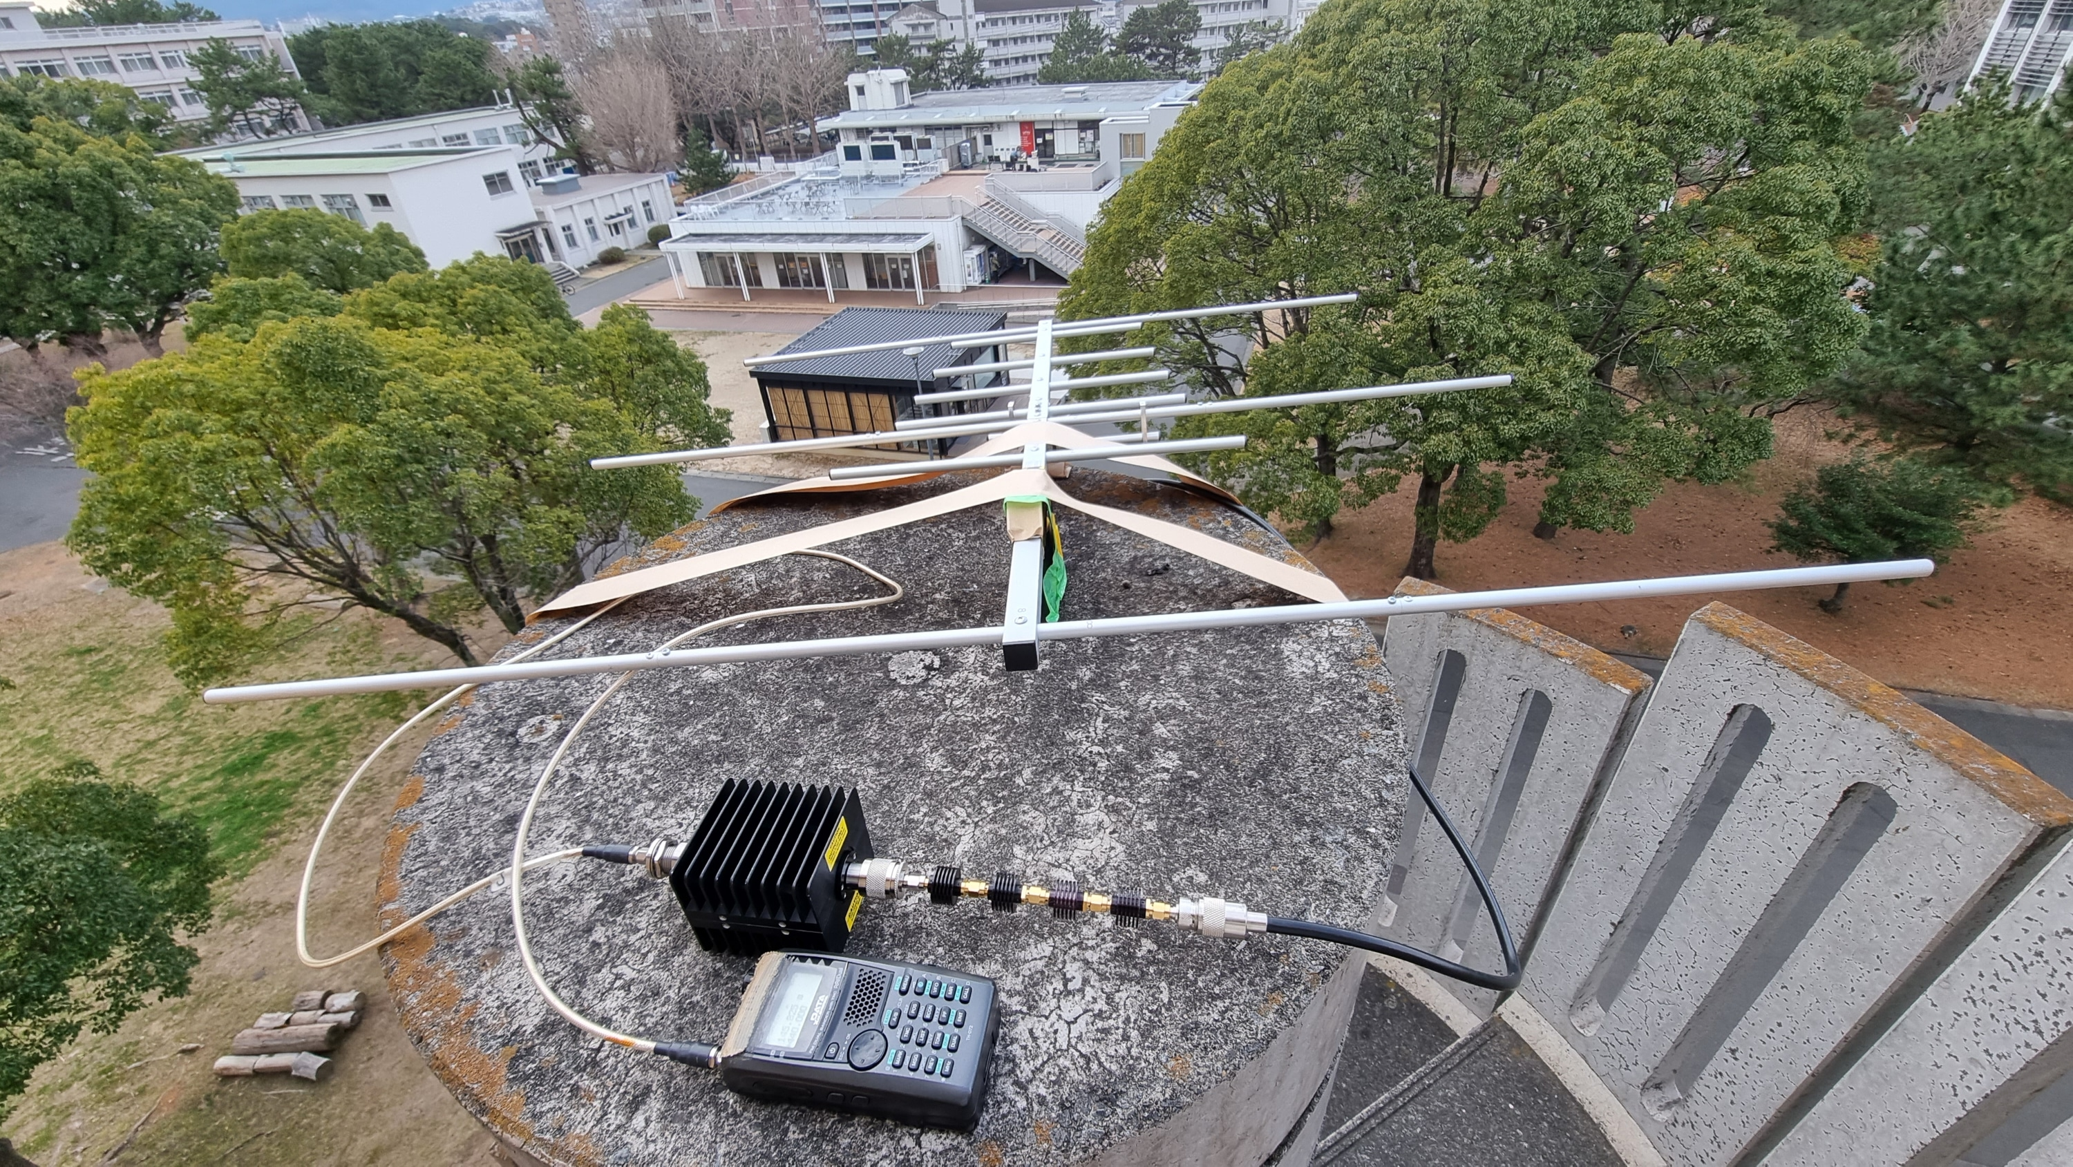
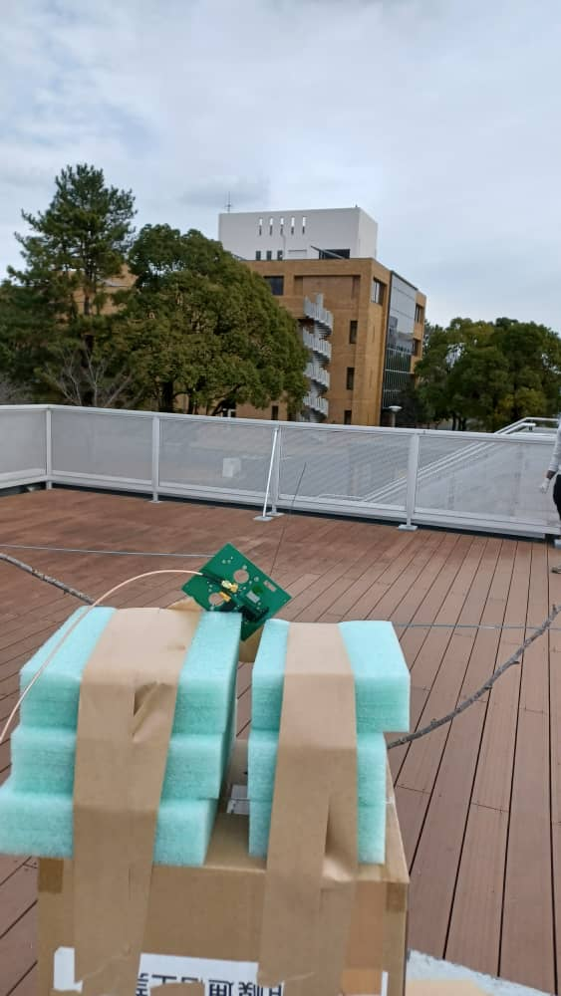
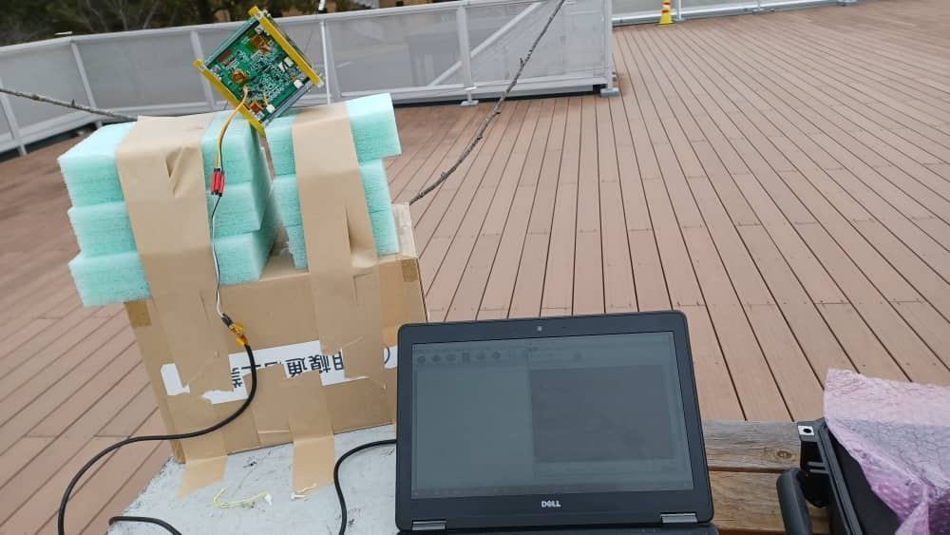
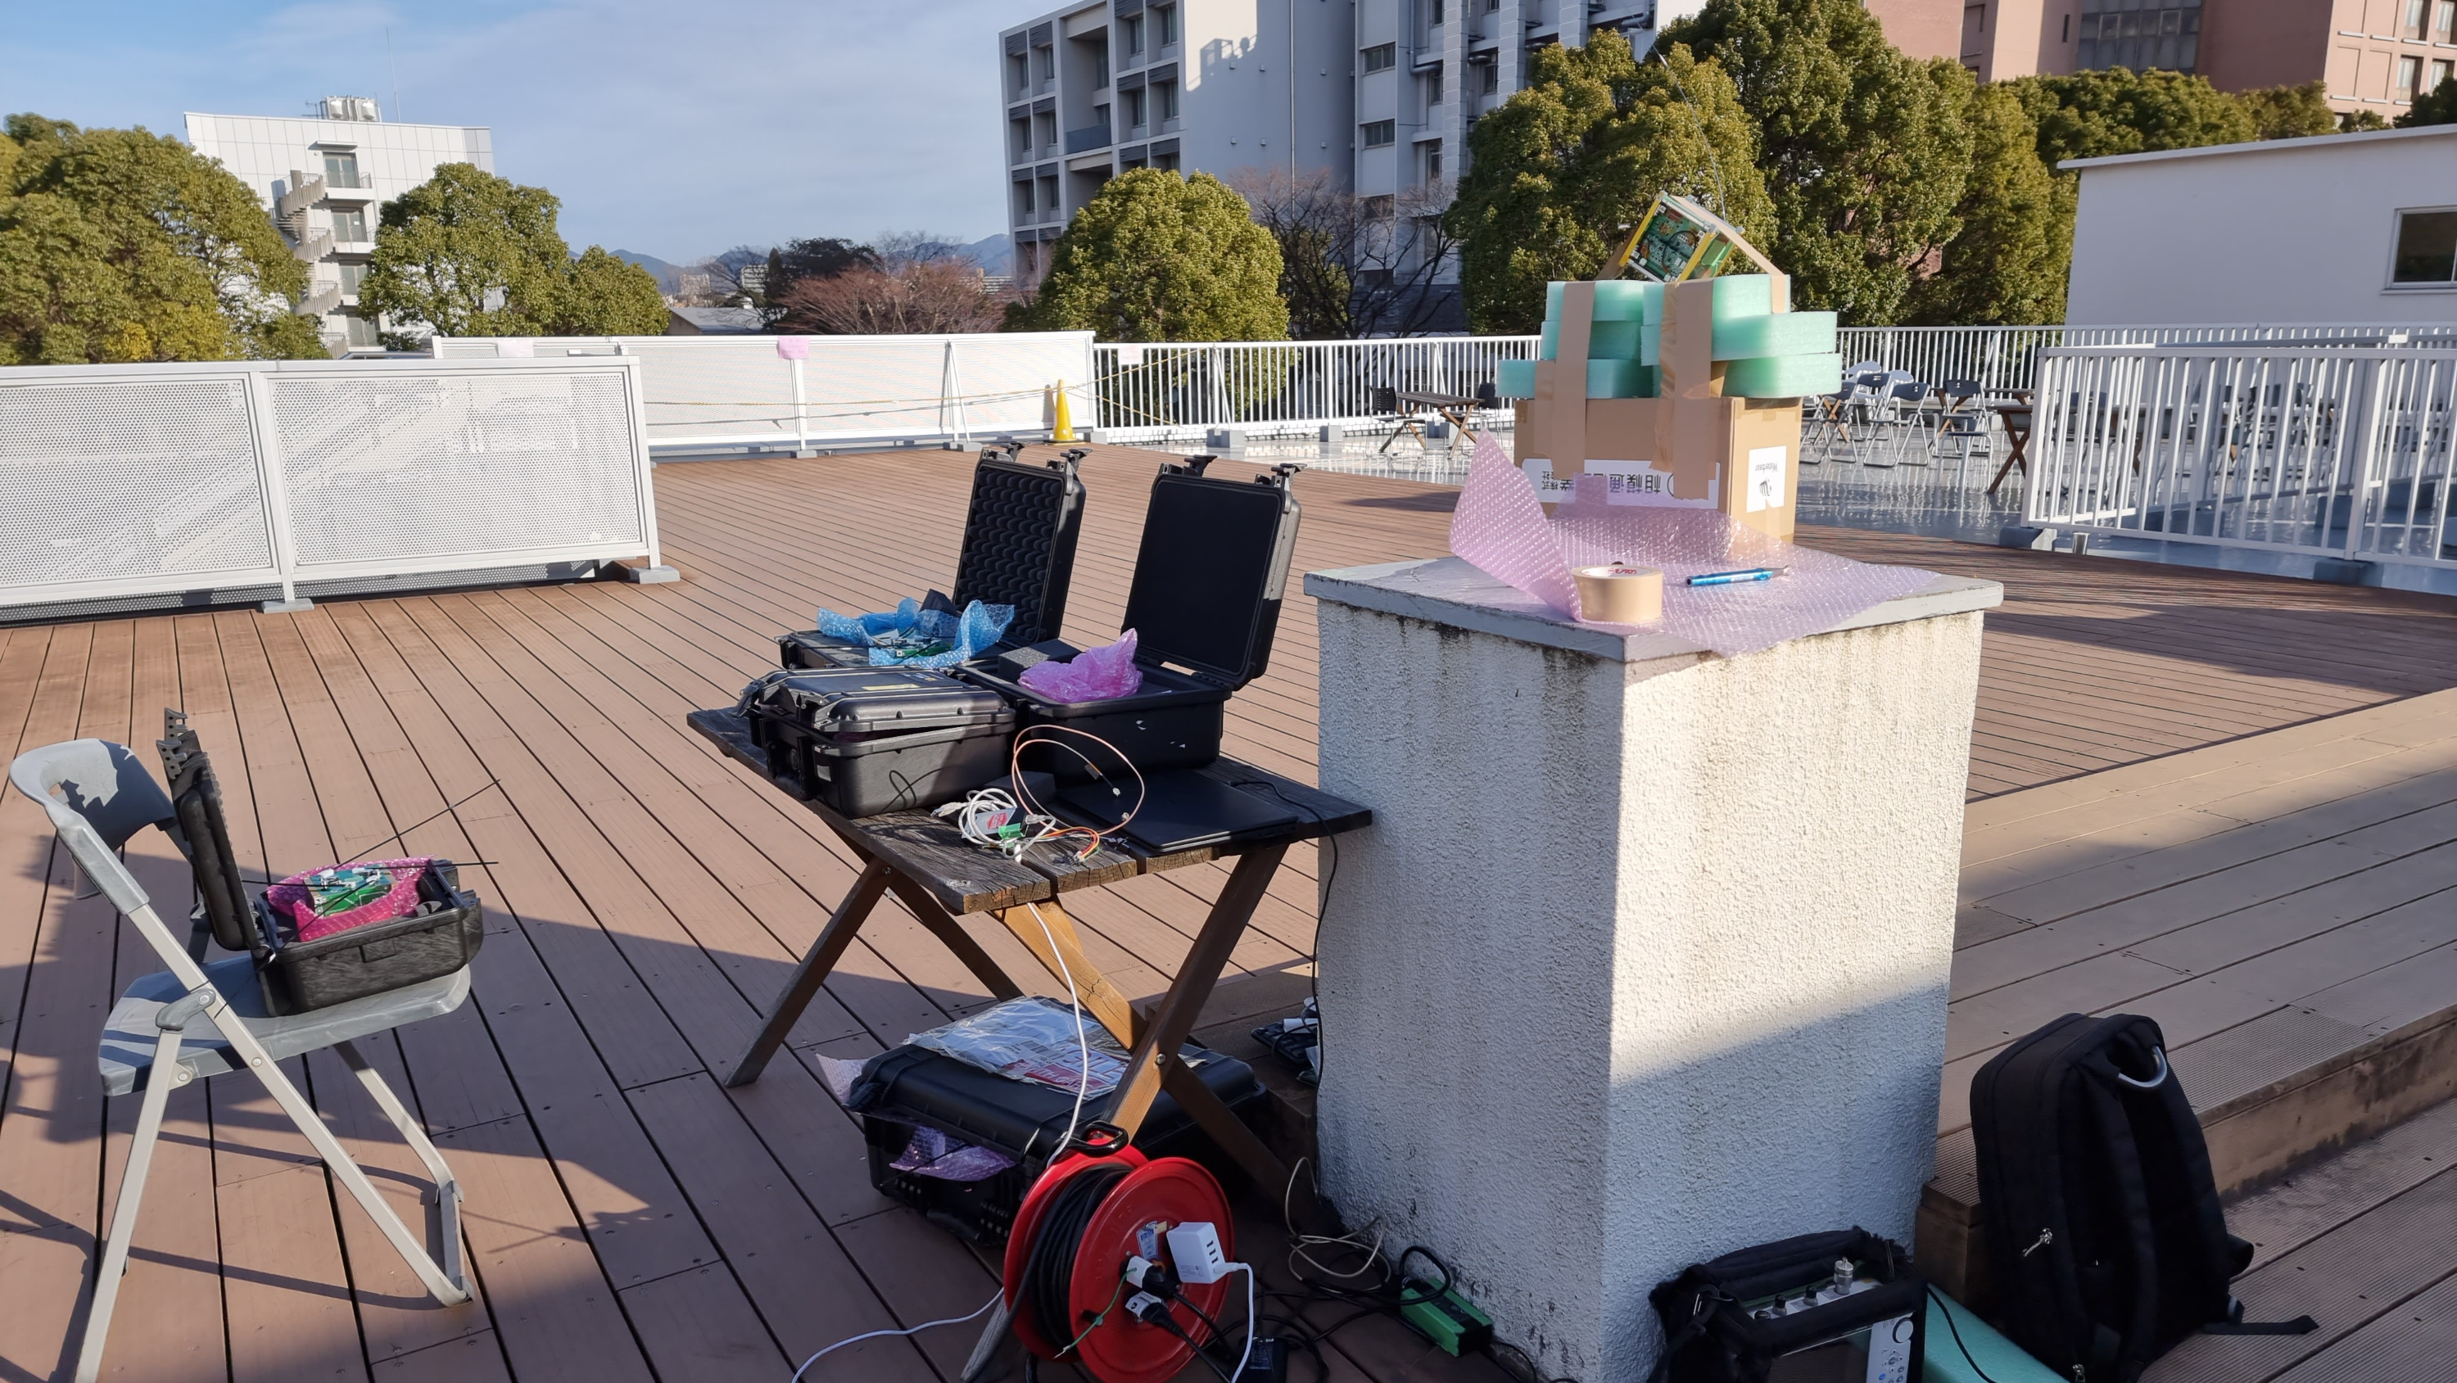
VHF Test Setup
GST Side
Pointing and Calibration
Mission: On/OFF with Serial Cable
Satellite Side
Serial Cable Turn On and Off the Mission

Slide 3
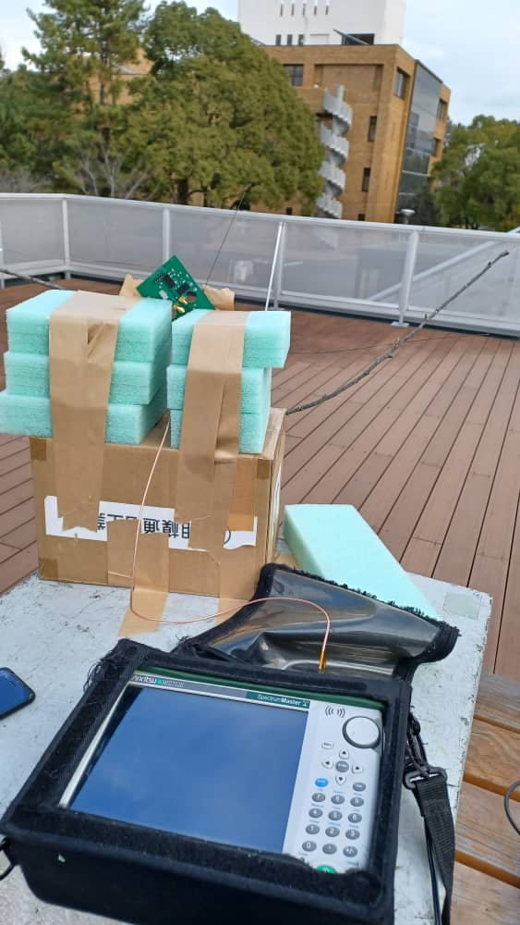
Long Range Test: VHF
Position 1
Measured Parameters:
Radio Output Power:
Extremely Low Power: 17.3 dBm
Antenna Calibration
Check Consistence of the received power at the satellite antenna
Same Received Power for all antennas observed
Increase attenuation
Antenna Consistence
Position2

Slide 4
VHF Sensitivity Test Results
Attenuators (dB) | Total Attenuation (dB) | Pexp (dBm) | Prx (dBm) | Sat1 (S.R) | Sat2 (S.R) | Sat3 (S.R) | Sat4 (S.R)
73 | 125.3 | -98 | -98.2 | 4/4 | 4/4 | 4/4 | 4/4
75 | 127.3 | -100 | -100.1 | 4/4 | 4/4 | 4/4 | 4/4
76 | 128.3 | -101 | -101.2 | 3/4 | 4/4 | 4/4 | 4/4
78 | 130.3 | -103 | -103.1 | 1/4 | 3/4 | 4/4 | 2/4
80 | 132.3 | -105 | -104.8 | 0/4 | 0/4 | 1/4 | 0/4
82 | 134.3 | -107 | -106.9 | 0/4 | 0/4 | 0/4 | 0/4
83 | 135.3 | -108 | -108.0 | 0/4 | 0/4 | 0/4 | 0/4
93 | 145.3 | -118 | ---- | 0/4 | 0/4 | 0/4 | 0/4
S.R => Success Rate

Slide 5
Comparison of VHF Sensitivity Testing
Transceiver | Anechoic Chamber Test | Long Range Test
Sat1 | -98 dBm | -101dBm
Sat2 | -98 dBm | -103dBm
Sat3 | -98 dBm | -103 dBm
Sat4 | -96 dBm | -101dBm

Slide 6
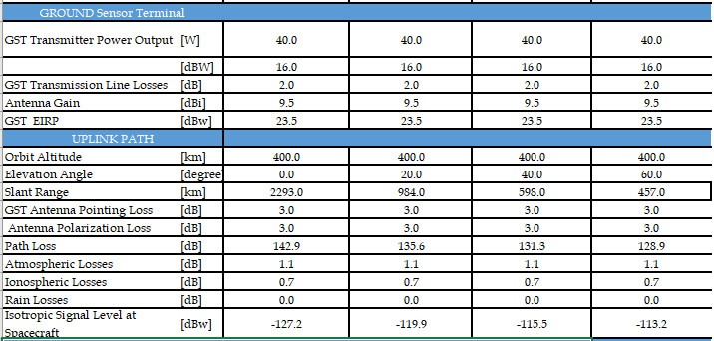
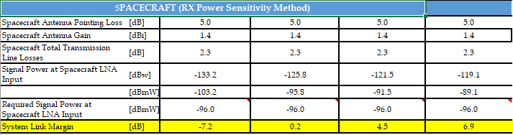
Uplink Budget VHF

Slide 7
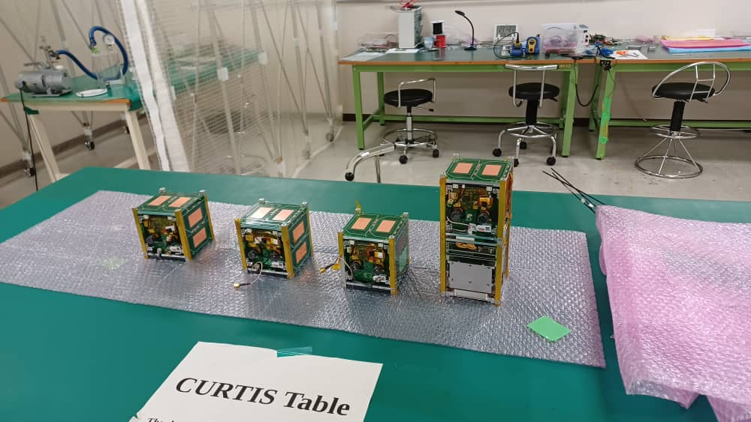
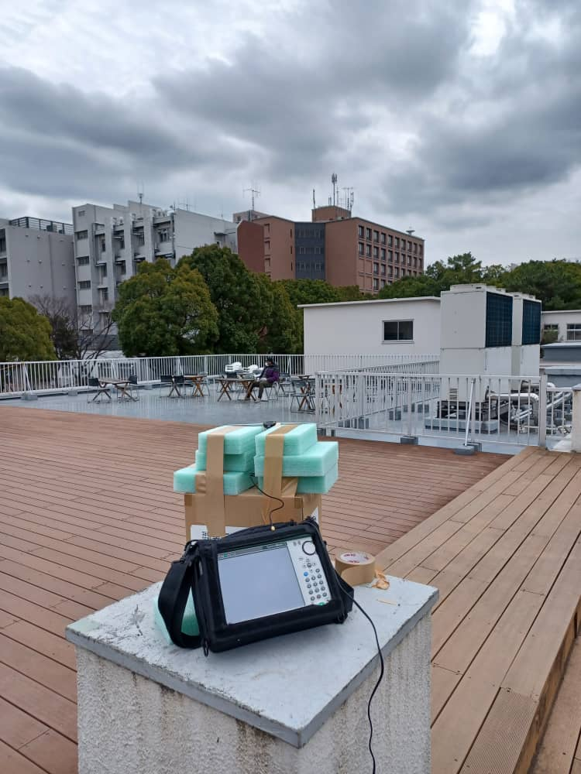
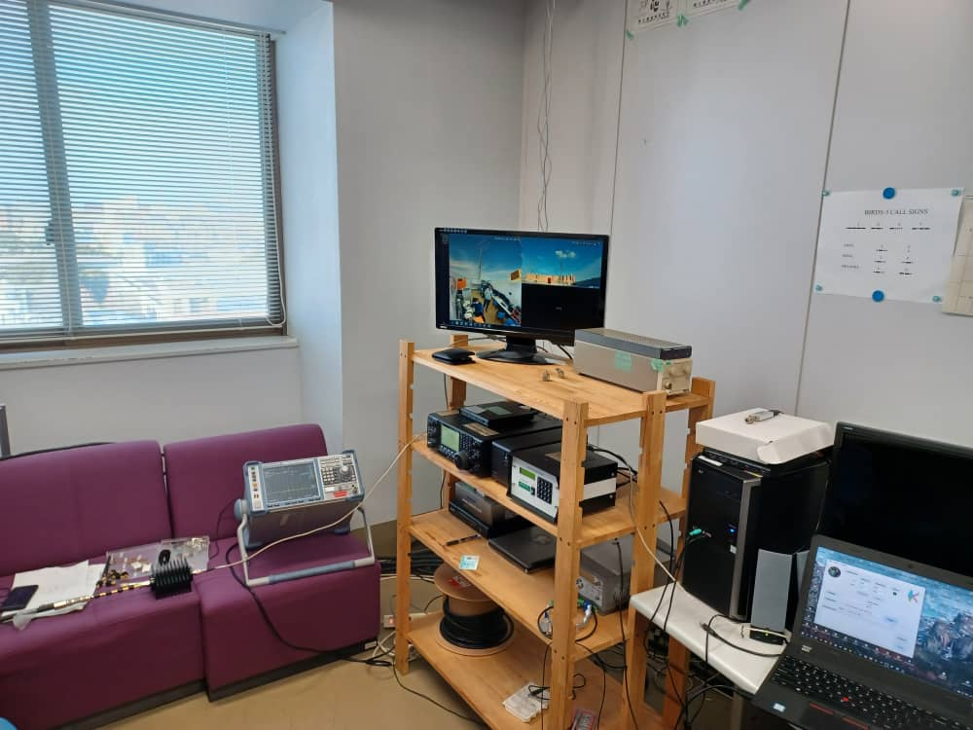
UHF Test Setup Scenarios
Pointing and Calibration
GS Antenna
Prepared Satellite
Commercial Dipole Antenna
Inside the GS
Satellite Side

Slide 8
UHF Long Range Test
Measured Parameters:
Radio Output Power:
Low Power: 33.4 dBm
Measured Satellite CW Power from all Satellites:
CW Power: ~19dBm
GS Antenna Pointing
Az: 327.79 deg
Elevation: -17.3 deg
Confirm Effective Uplink and Downlink Attenuation for all satellites
EUA=PTX(UL)-PRX(UL)
EDA=PTX(DL)-PRX(DL)
EUA equivalent to EDA
Satellite | Transceiver | EUA (dB) | EDA (dB)
Sat1 | TRX1: New A | 79.9 | 79.5
Sat 2 | TRX2: New B | 79.9 | 78.0
Sat3 | TRX3: New C | 80.4 | 80.0
Sat 4 | TRX4: 2U Only | 80.4 | 79.4

Slide 9
UHF Uplink Sensitivity Results
Attenuators (dB) | Total Attenuation (dB) | Pexp (dBm) | Prx (dBm) | Sat1 (S.R) | Sat2 (S.R) | Sat3 (S.R) | Sat4 (S.R)
70 | 149.9 | -94 | -94.5 | 6/6 | 6/6 | 6/6 | 6/6
76 | 155.9 | -100 | -99.8 | 6/6 | 6/6 | 6/6 | 6/6
78 | 157.9 | -102 | -101.7 | 6/6 | 6/6 | 6/6 | 6/6
79 | 158.9 | -103 | -102.6 | 6/6 | 6/6 | 6/6 | 5/6
80 | 159.9 | -104 | -103.4 | 6/6 | 6/6 | 5/6 | 3/6
81 | 160.9 | -105 | -104.6 | 4/6 | 5/6 | 1/6 | 4/6
82 | 161.9 | -106 | -105.5 | 4/6 | 5/6 | 0/6 | 2/6
83 | 162.9 | -107 | -106.6 | 1/6 | 2/6 | 0/6 | 0/6
S.R => Success Rate

Slide 10
Comparison of UHFSensitivity Testing
Transceiver | Anechoic Chamber Test | Long Range Test
TRX1 (New A) | -102dBm | -105dBm
TRX2 (New B) | --- | -105dBm
TRX3 (New C) | --- | -103 dBm
TRX4 (2U Only) | -101 dBm | -104 dBm

Slide 11
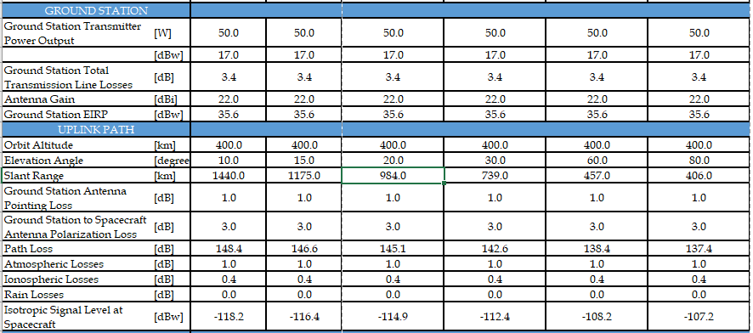
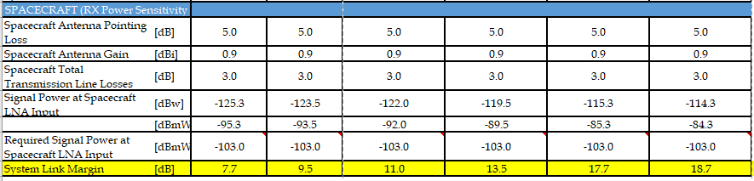
UHF UPLINK BUDGET
Command Uplink GMSK

Slide 12
Link Budget Comparison
BIRDS Project | Link Margin
 | 10⁰ Elevation | 15⁰ Elevation | 20⁰ Elevation | 30⁰ Elevation | 60⁰ Elevation | 80⁰ Elevation
BIRDS-3* | 4.1 dB | 5.9 dB | 7.4 dB | 9.9 dB | 14 dB | 15.1 dB
BIRDS-4 | 8.8 dB | 10.5 dB | 12.1 dB | 14.5 dB | 18.7 dB | 19.8 dB
BIRDS-5FM | 7.7dB | 9.5dB | 11.0 dB | 13.5 dB | 17.7 dB | 18.70 dB
*BIRDS-3 link margin calculation was based on in-orbit data.
BIRDS-4 link margin is approx. 5 dB and 1 better than BIRDS-3 BIRDS-5 respectively.
BIRDS-5 is approx. 4dB better than BIRDS -3.

Slide 13
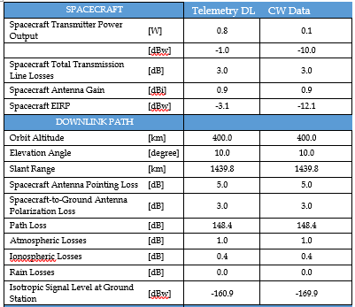
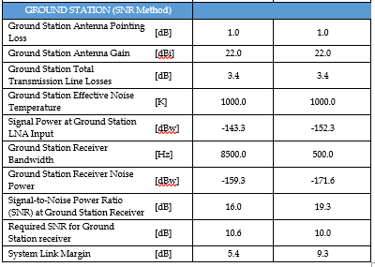
UHF DOWNLINK BUDGET

Slide 14
Long Range and Long Duration Transceiver Performance
Satellite | Transceiver | Uplink | GMSK Downlink | CW
Satellite1_FM | TRX1-NewA | OK | OK | OK
Satellite2_FM | TRX2-New B | OK | OK | OK
Satellite3_FM | TRX3-New C | OK | OK | OK
Satellite4_FM | TRX4_2U Only | OK | OK | OK
Note:
All Transceiver Power Consumption is normal
No more Reset Problems

Slide 15
Next Tasks
TVT

